Slide 1
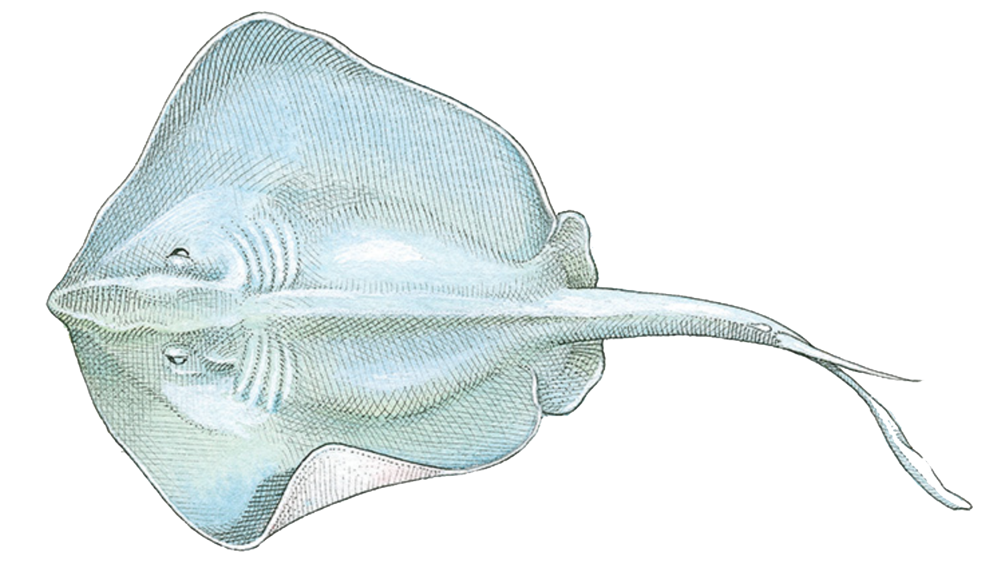
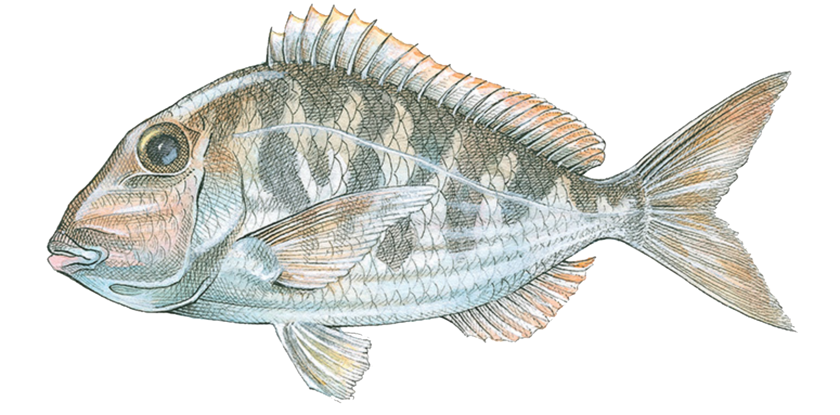
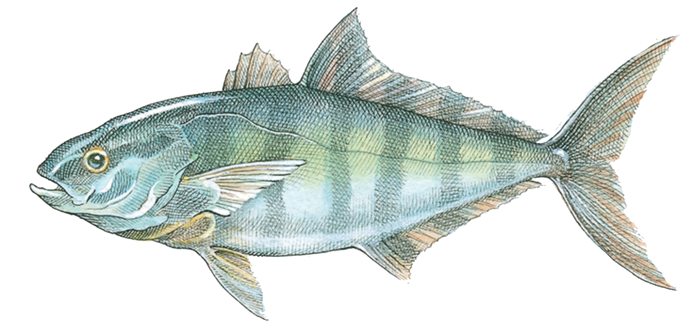
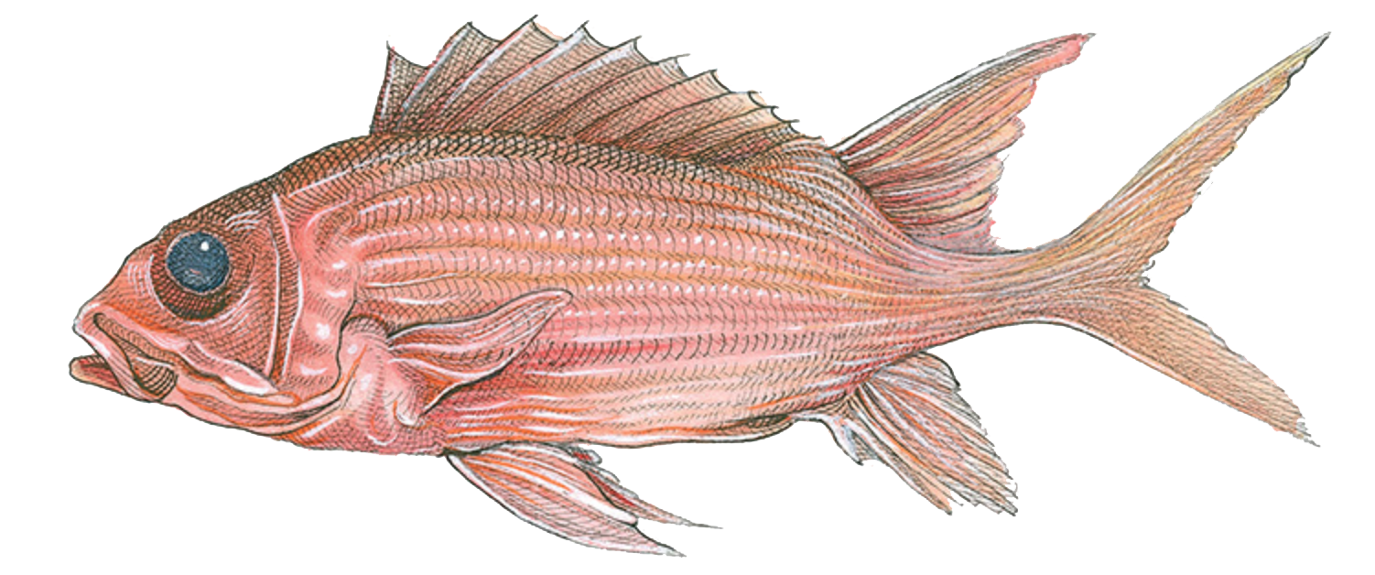
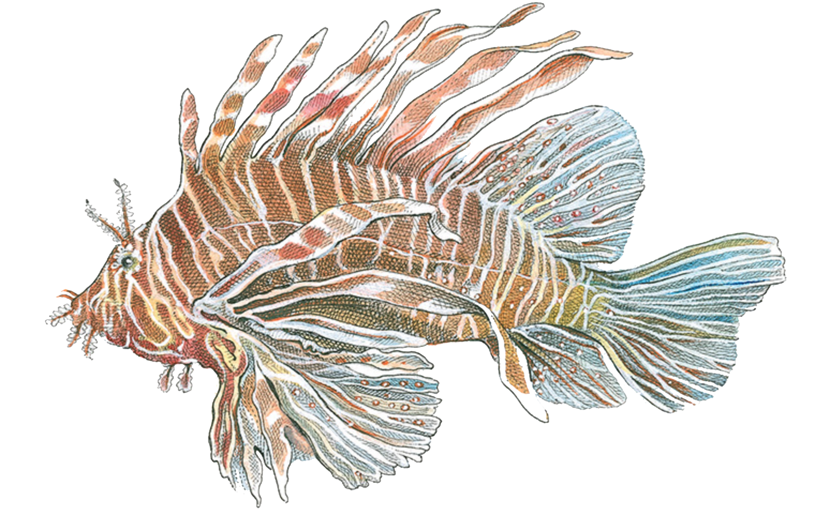
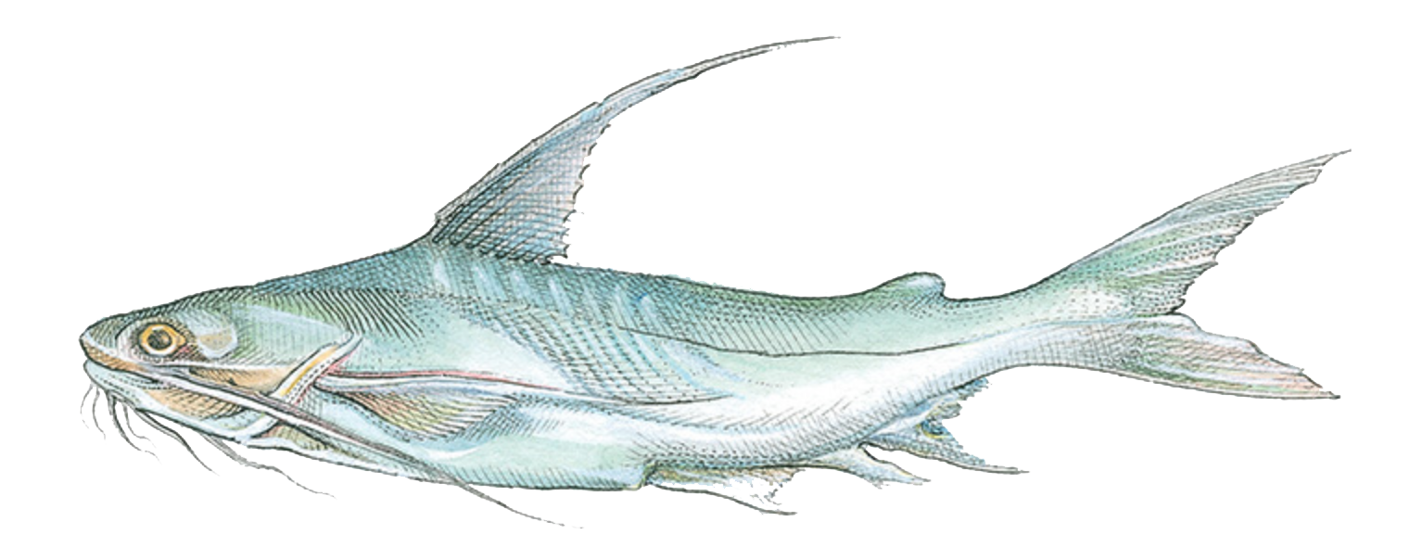
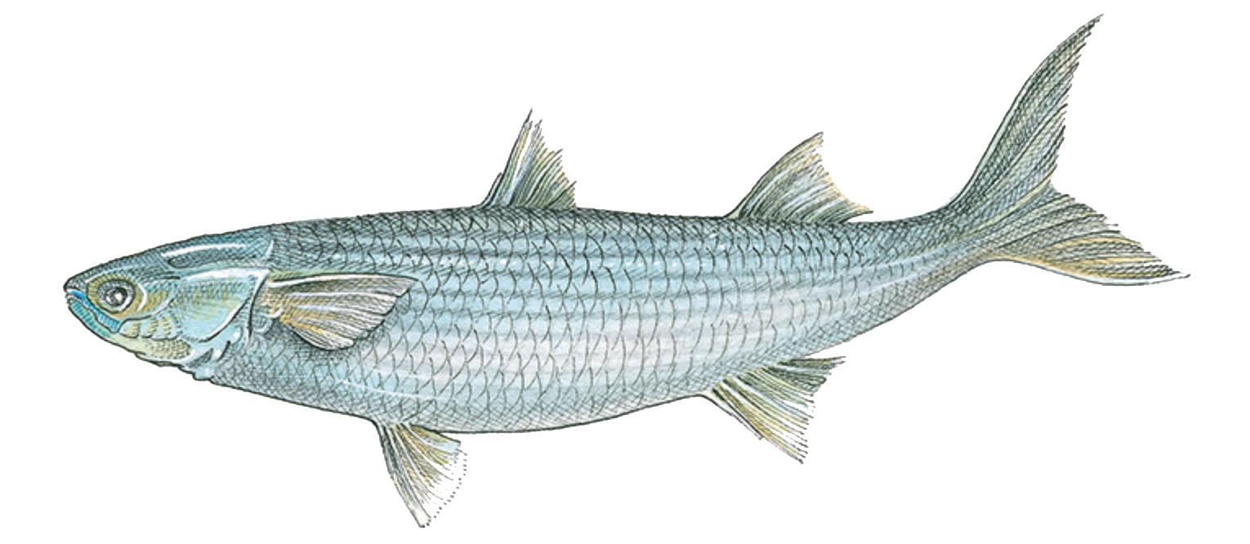
Name That Fish
Fish Classification Test
Directions:
Rename the file with your name and fish test (Joseph.fishtest)
Save the file in your folder
Make a text box
Write the name of the fish
Cite the source
Save the file again
Drop the finished test into drop box

Slide 2
Croaker www.floridagofishing.com

Slide 4
Snapper black fin www.floridagofishing.com

Slide 6
Porgy red www.floridagofishing.com

Slide 9
Lionfish www.floridagofishing.com

